Slide 1
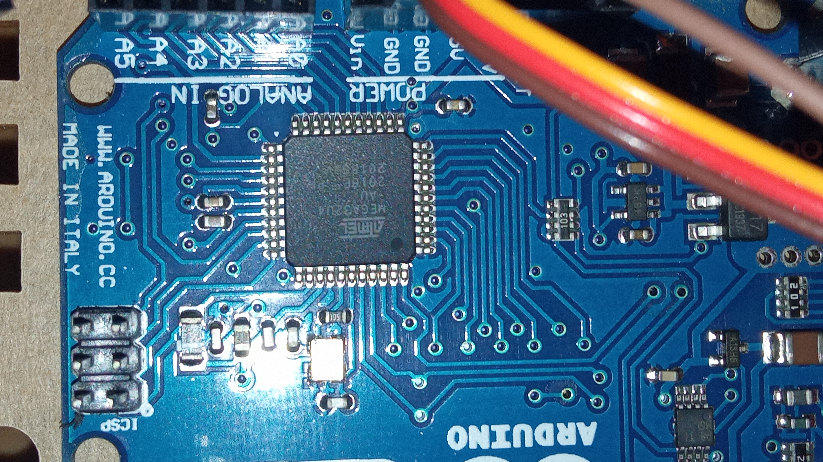
UNDERSTANDING
MICROCONTROLLER
DATA FORMAT AND
DIRECTIVES: A
COMPREHENSIVE
OVERVIEW
By Shohag 2003028

Slide 2

MICROCONTROLLER DATA FORMAT
AVR data type
The AVR microcontroller has only one data type. It is 8 bits, and the size of each register is also 8 bits.
Data format representation
There are four ways to represent a byte of data in the AVR assembler. The numbers can be in hex, binary', decimal, or ASCII formats.

Slide 3

DATA FORMAT REPRESENTATION
• Hex numbers
Ox (or OX) or $ in front of the number $75 or 0x11
• Binary numbers
Only B infront of the number
0b10011001
• Decimal numbers
No special representation 75
• ASCII Characters
Only B infront of the number
'2' - 00110010 or 32 in hex.

Slide 4
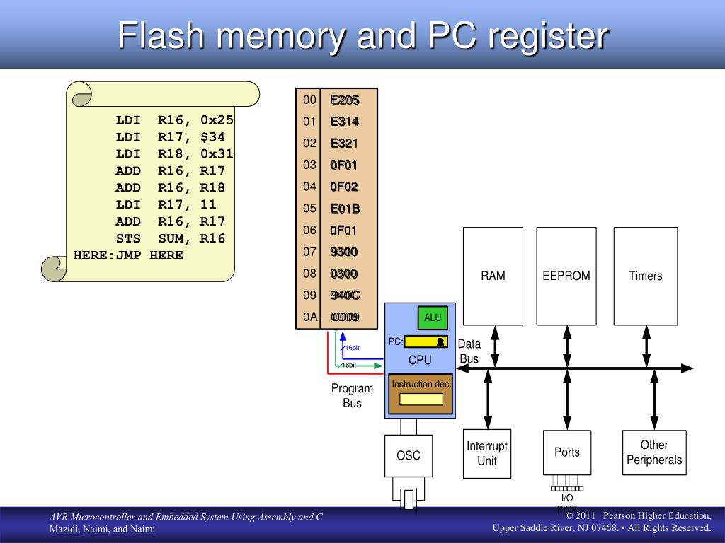
MICROCONTROLLER DIRECTIVES
Directives in AVR microcontroller programming provide instructions to the assembler
while instructions tell the CPU what to do.

Slide 5
.EQU (equate)
To define a constant value or a fixed address. .EOU COUNT = 0x25
Note: .EQU can be used for RAM address assignment and SFR address assignment
.SET
To define a constant value or a fixed address by the value may be reassigned later the .SET directive.

Slide 6
.ORG (origin)
To indicate the beginning of the address. It can be used for both code and data.
.INCLUDE directive
To add the contents of a file to our program (like the #include directive in C language).

